Slide 1
Using Bridgemate IIs with EBU Score or Scorebridge
Setting up and Problem Solving

Slide 2
Plan for the Day
Over-View of Bridgemate System
Computer Requirements
Movements & Scoring
Setting up a Tournament
Troubleshooting
”Hands On” Session – Running a Tournament
End of Tournament Procedures
Q&As

Slide 3
How it Works

Slide 4
Wireless Technology Issues
The current Bridgemate II was launched in 2010 – so old technology!
They use Band 868 (863-870 MHz) ISM, the next band up from UHF. (LoRa & IoT)
Within that Band, they use 8 Channels (0-7 – default 0)
WiFi uses 2,400 MHz and 5,000 MHz (2.4 GHz & 5 GHz)
Compared to WiFi, the band used by Bridgemates is slower and carries much less data, but has a considerably better range – 175 m in an open room
If this not enough, use a second Server. Limit of 256 Bridgemates per server.

Slide 5
Computer (Usually Laptop)
Nothing fancy but speed is always nice
15” Screen or bigger is nice but not essential
Decent Keyboard, Numeric Keypad & Mouse very useful
Sufficient USB ports (Bridgemate Server uses USB A port)
Win 10 or 11 or MacOS 14 with emulator
Internet connection and/or Printer
On Windows, set working time to Bridge Time!

Slide 6
Keep Software up to Date
Operating System
Bridgemate Control Software (BCS) 3.9.9 (28/9/2022)
Bridgemate Firmware 3.1.1 (4/1/2021)
Bridgemate Server Firmware 3.1.1d (4/1/2021)
Scorebridge 10.24.01
EBUScore Pairs 1.2.20
EBUScore Teams, Individual, Swiss Pairs & Swiss Teams 1.2.11

Slide 7
Scorebridge EBUScore
Stephen Bligh 2007
Standard supports all movements except Swiss Teams. Bridgemate support Addon
Cost €275 (+€40) plus €67-€74 p.a.
Primary plus 5 other named people
Excellent Support
Clunky
EBU 2016 from Jeff Smith’s Scoring Prog
Suite of 5 progs with native Bridgemate support
Cost £60 plus £48 p.a.
All Club Members
Excellent Support
Powerful

Slide 8
SOP
Connect Bridgemate Server, Mouse & Printer to Computer
Connect Computer to Mains, Turn on Computer and Log in
Launch EBU Score or Scorebridge
Create Event
Load Deal File (if using)
Select Movement & Launch Bridgemate Control Software

Slide 9
5 Table Mitchell Round 1
NS1vEW1
BS-A
NS2vEW2
BS-B
NS3vEW3
BS-C
NS4vEW4
BS-D
NS5vEW5
BS-E

Slide 10
Round 2
NS1vEW5
BS-B
NS2vEW1
BS-C
NS3vEW2
BS-D
NS4vEW3
BS-E
NS5vEW4
BS-A

Slide 11
Round 3
NS1vEW4
BS-C
NS2vEW5
BS-D
NS3vEW1
BS-E
NS4vEW2
BS-A
NS5vEW3
BS-B

Slide 12
Round 4
NS1vEW3
BS-D
NS2vEW4
BS-E
NS3vEW5
BS-A
NS4vEW1
BS-B
NS5vEW2
BS-C

Slide 13
Round 5
NS1vEW2
BS-E
NS2vEW3
BS-A
NS3vEW4
BS-B
NS4vEW5
BS-C
NS5vEW1
BS-D

Slide 14
6 Table Mitchell Round 1
NS1vEW1 BS-A
NS2vEW2
BS-B
NS3vEW3
BS-C
NS4vEW4
BS-D
NS5vEW5
BS-E
NS6vES6
BS-F

Slide 15
Round 2
NS1vEW6 BS-B
NS2vEW1
BS-C
NS3vEW2
BS-D
NS4vEW3
BS-E
NS5vEW4
BS-F
NS6vES5
BS-A

Slide 16
Round 3
NS1vEW5 BS-C
NS2vEW6
BS-D
NS3vEW1
BS-E
NS4vEW2
BS-F
NS5vEW3
BS-A
NS6vES4
BS-B

Slide 17
Round 4 – oops!!!
NS1vEW4 BS-D
NS2vEW5
BS-E
NS3vEW6
BS-F
NS4vEW1
BS-A
NS5vEW2
BS-B
NS6vES3
BS-C

Slide 18
Mitchell Movement
2 Winner Competition
Ideally, no of rounds = no. of tables.
+/- 1 acceptable, +/- 2 poor
Easy (Mitchell was a bank clerk, Howell was a mathematician)
Straight for odd number, Skip or Share & Relay for even
Phantom Pairs & Mythical Shares
For a one-winner Mitchell, (Switched Mitchell), arrow switch 1/8 of rounds

Slide 19
Howell Movements Full, Partial (¾) or Curtailed
Full Howell has one sitting pair (the pivot pair) classically seated NS at the highest numbered table. Movement is complex (Cards)
It has 2T-1 Rounds. Great one winner movement if you can live with it!
In a ¾ Howell, you subtract one round and add a second sitting pair or subtract 2 rounds and add a third sitting pair or……… Save yourself the bother and just have a cup of tea and a raffle – the results will be just as accurate
BBO uses Flower Howells which are less wonderful, especially if curtailed

Slide 20
Suggested Movements
Fewer that 7 tables – Full Howell
Odd Number of Tables – Straight Mitchell (hesitation for 7T/24B)
Even Number with no half table – Skip Mitchell or Share/Relay
If Share & Relay, the half table should be highest number and share with T1
Even Number with half table – Share and Relay. The share is phantom
Nine and a Half Tables – Use 1.5 Table Appendix Mitchell
Ten Full Tables – Use Blackpool
Best Practice is that a missing pair is N/S (can be mandatory)
The sit-out pair get a Bridgemate to enter their Numbers

Slide 21
More Complicated Movements
Two parallel events i.e. Running two separate events using one Bridgemate Server
Scoring Programs were not originally designed to do this. EBUScore does a reasonable job. Scorebridge manages it really badly.
Genuine 2 Section events are much easier.
Two section, two session events are beyond the scope of this seminar
Individual events are cumbersome but work reasonably well
Teams events.

Slide 22
Passed Out, Averaged or Not Played?
If Board is passed out, enter Pass on Bridgemate. NS and EW are both given a score of 0 MPs for that board.
If a board can’t be completed, usually for want of time, assign a proper bridge score if you can.
If you can’t, assign Average to NS and EW if they were both somewhat at fault
If they were both totally pure as the driven snow, assign 60% to both
If one pair were totally blameless and the other pair were at fault give guilty pair 40% and blameless pair 60%
No not use the NOT PLAYED function for any of the above. That’s against Law 12,C,2,a

Slide 23
Multi Function Keys
J & +
Q & -
K & Passed Out
A and =
10 used for 0 or 10 and Not Played

Slide 26
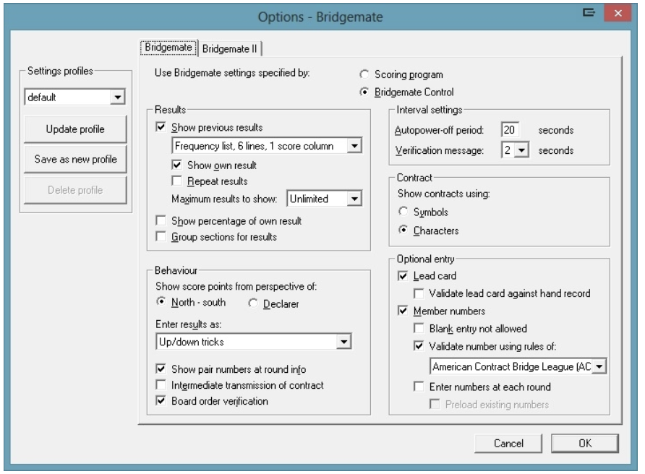

Slide 27
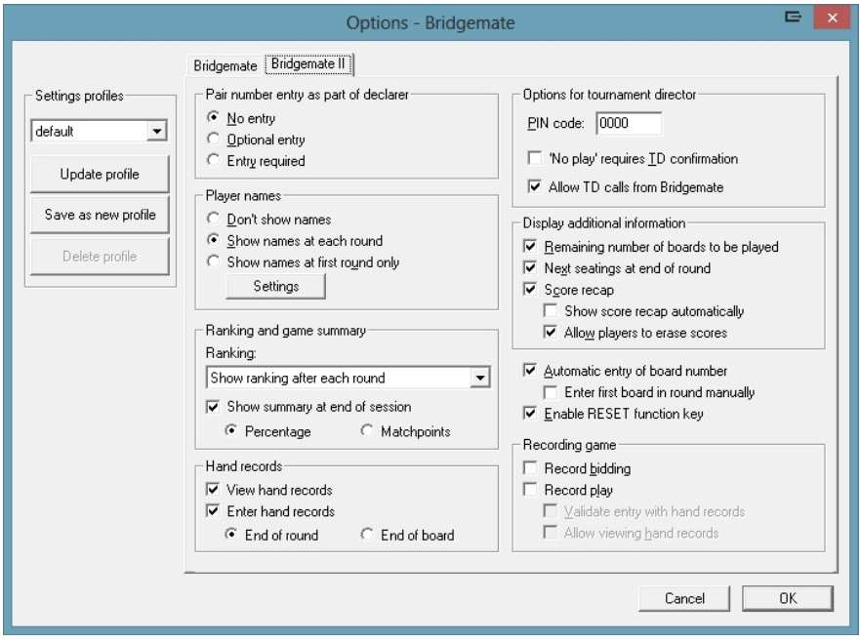

Slide 28
Setting up a tournament

Slide 29
What can go Wrong?
You put in the Wrong Movement
Poor communication with TD
Forget it’s a Single Winner Mitchell
You put the movement in too early
Someone Arrives Late

Slide 30
Changing the movement During first round
Delete the event
Re-enter
Create New Database
Players must re-enter their numbers and early scores
OR
Redefine the movement
Restart with new database and don’t retain the results

Slide 31
Later – Forgotten arrow switch
Redefine Movement
Update from Round n where n is after current round

Slide 32
During Competition
Wrong Name or Name Omitted – Fix at any table OR record on paper
Wrong Score – Fix at table using TD menu OR record on paper
Simple error in score
Omitting Double
Playing in Wrong Order
Assigning Adjusted Scores, Pass Outs, Not Played – Bridgemate
Accidentally close EBUScore or BCS – NEVER CLICK AN X!!!
Hardware Problems

Slide 33
Hardware Problems
Individual Bridgemate Dies – Replace it with spare
Computer Dies but Bridgemates are working fine
Continue Game. Ensure Server is not turned off at end of session
Bridgemates Stop Working
Check the USB cable hasn’t disconnected
Go to Paper. The competition up to point of failure should be ok

Slide 34
Data recovery
Always possible
Usually easy e.g. retrieving data from server
At worst, tedious e.g. retrieving data from the Bridgemates
If you are referring the problem to an “expert”
Send the computer
Send the server and Bridgemates
DO NOT SWITCH THE SERVER OFF
There are decent batteries in it right? If so, you have about 48 hours

Slide 35
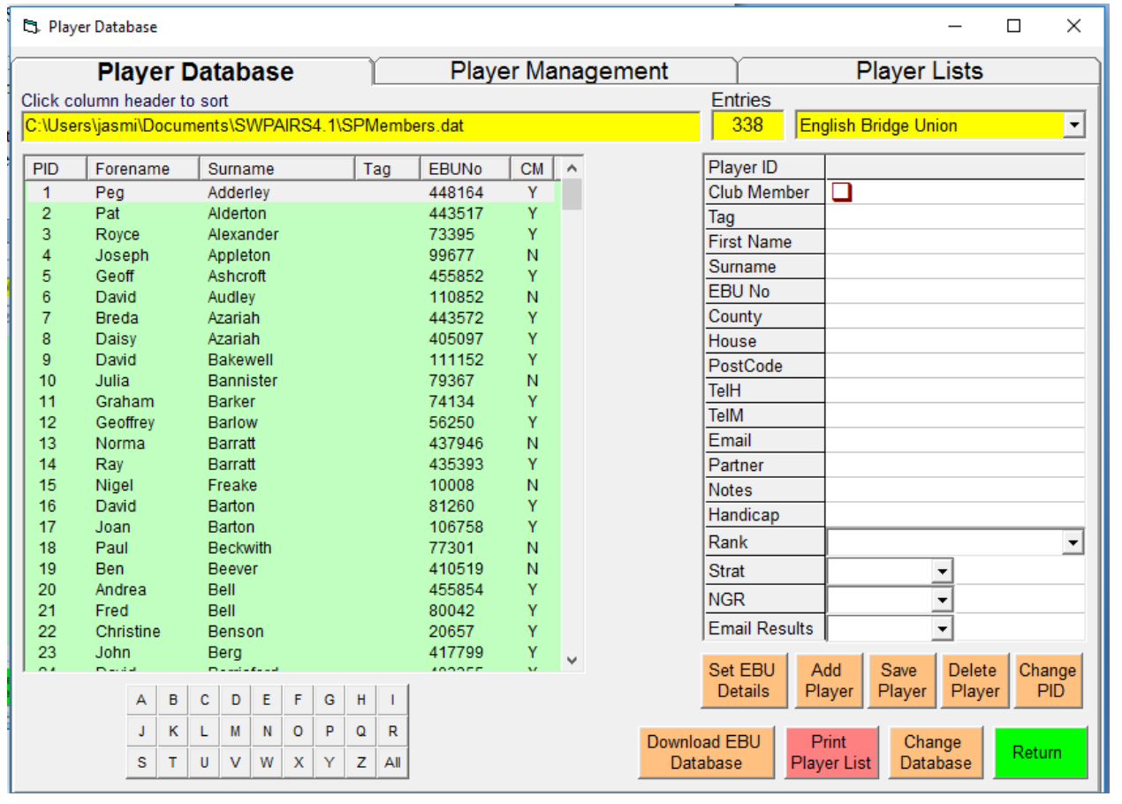

Slide 36
Lunch Break Followed by “Hands On” Session
Divide yourselves into groups of 4
Those who only want instructions on Scorebridge go to Dan or Patricia
Those who want only EBUScore or EBUScore and Scorebridge go to Aidan, Mary or Thérèse

Slide 37
End of Competition
Wait for last result to come in
Check Bridgemate Scoring Window in EBU Score. If necessary, force last results over from BCS
If rounds were unplayed, close them in BCS
Go to Reports page and display the Results on Screen. Check that all the boards are in
Do any manual adjustment requires in Enter Scores Screen & Player Name Screen AFTER all wireless data has come in
Incorrect scores
Fouled Boards, Missed Arrow Switches
Missing/Incorrect Names

Slide 38
End of Competition II
Go to Reports
Click Internet Functions
Click Create BridgeWebs File
Select Club Competition – Continue
The file is created and you are invited to upload it – Accept
You will get a message saying it worked or didn’t

Slide 39
End of Competition III
Exit BCS
Exit EBUScore or Scorebridge
Turn Off the Computer
Turn Off the Mouse
Turn Off the Printer
Disconnect the Server
Press and hold the Red Battery Off LED on the server until all the LEDs on the Server are Off (it takes a few seconds) UNLESS there was a problem!
Un-plug the Mains Lead

Slide 40
Questions & Answers

